Slide 1
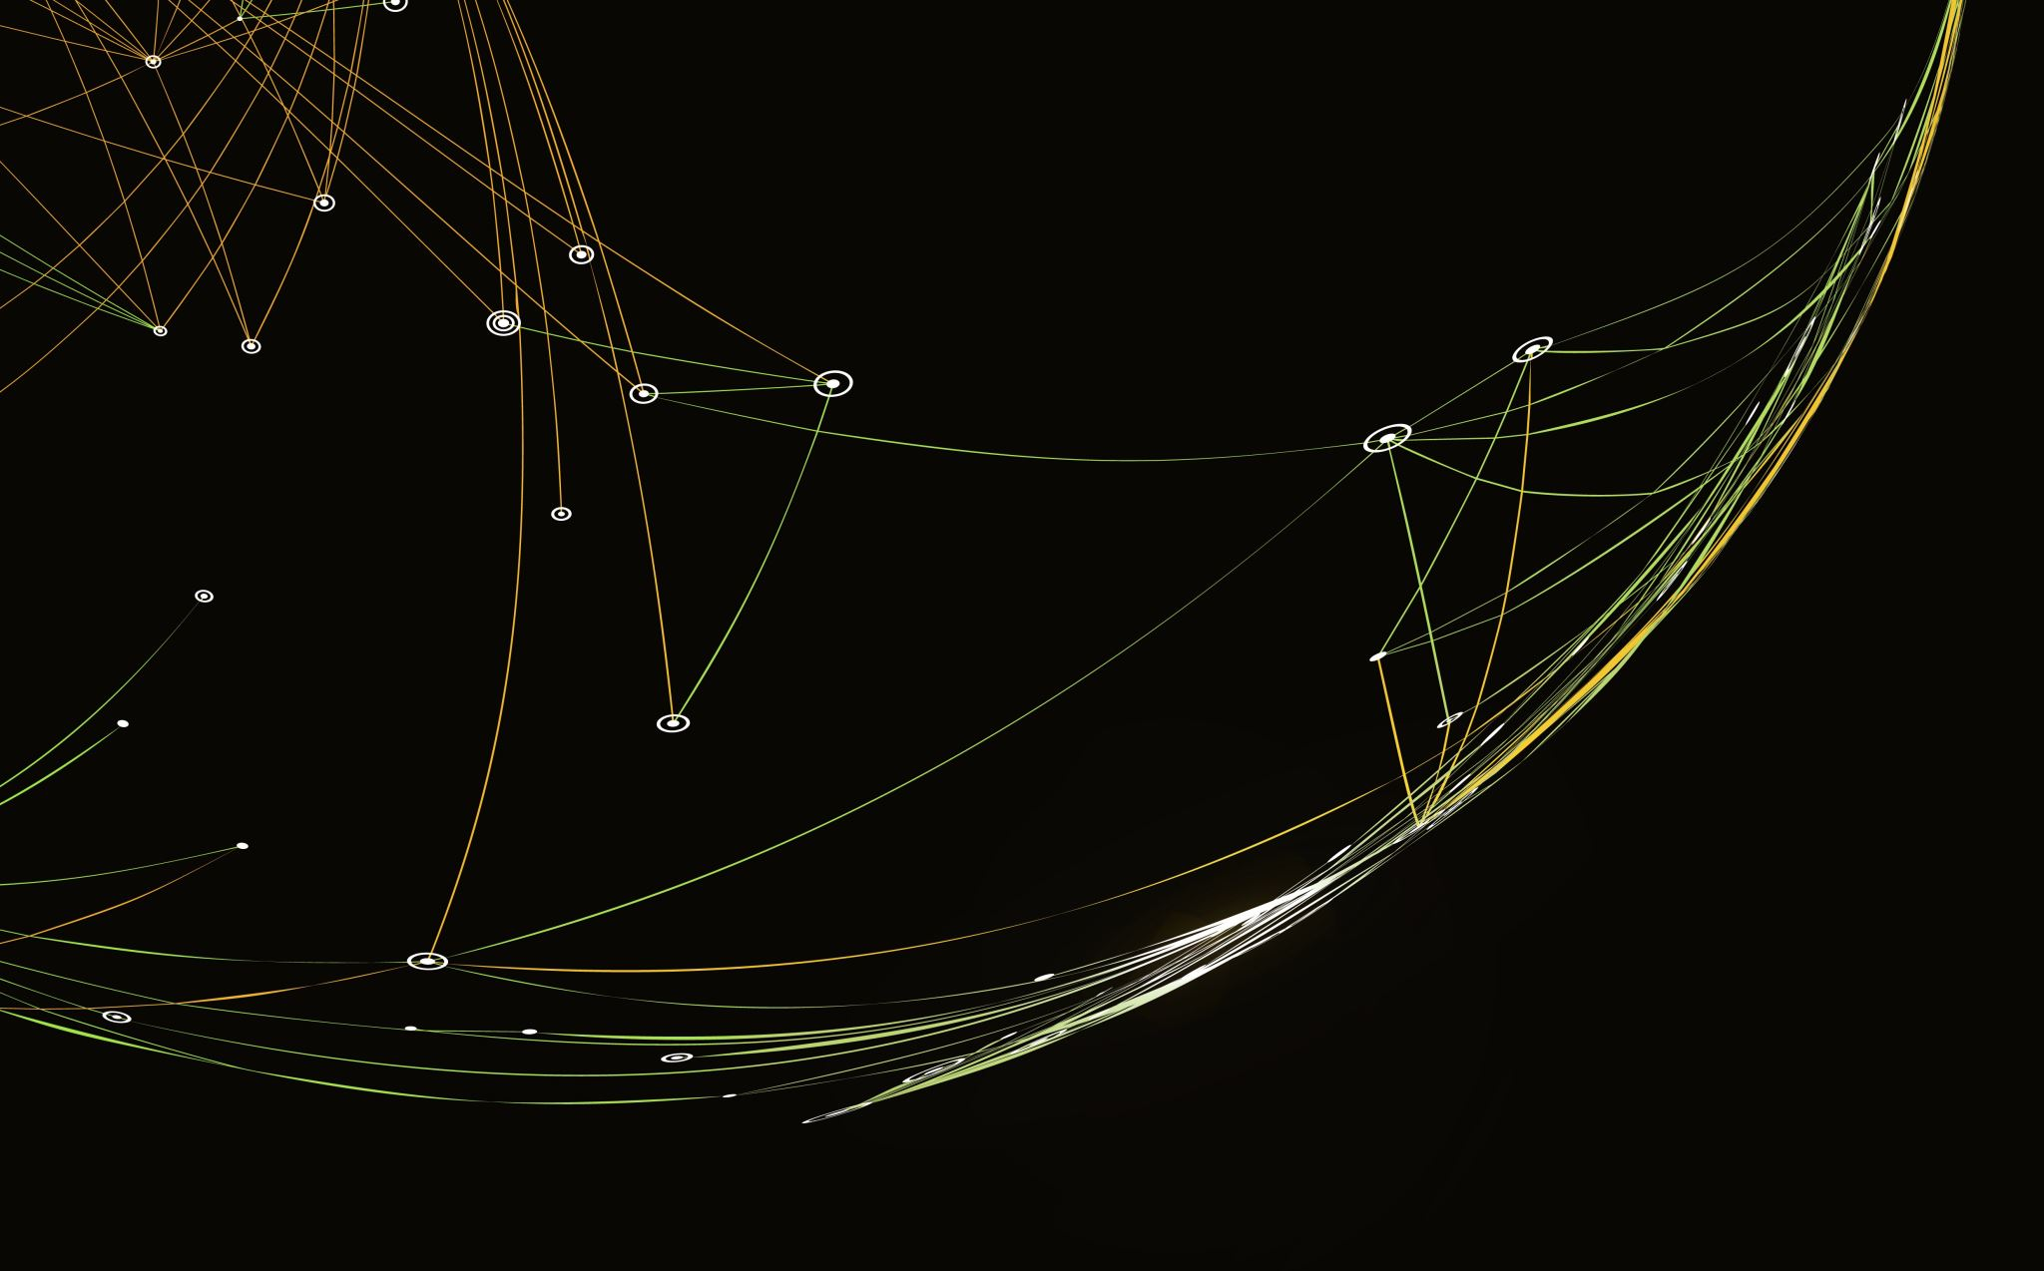
Cold War Timeline
Quang Huynh

Slide 2
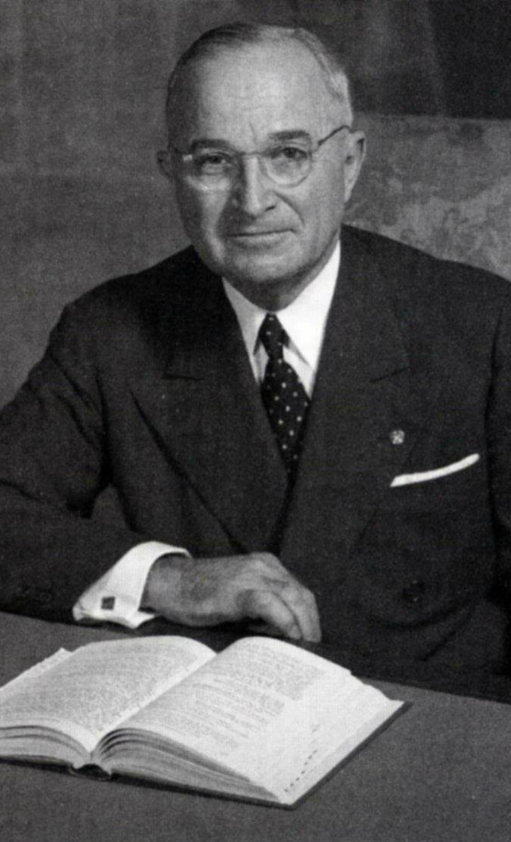
Truman Doctrine
A U.S. foreign policy established by President Harry Truman that attempted to resist communism. This policy stated that the U.S. would help any country that is threatened by communism.
The Truman Doctrine was made in 1947.
The Truman Doctrine was the response after the spread of Communism by the Soviet Union. The rivalry between the United States and Soviet Union would grow due to this policy. This would be known as the Cold War, the intense struggle between the Soviet Union and United States.

Slide 3
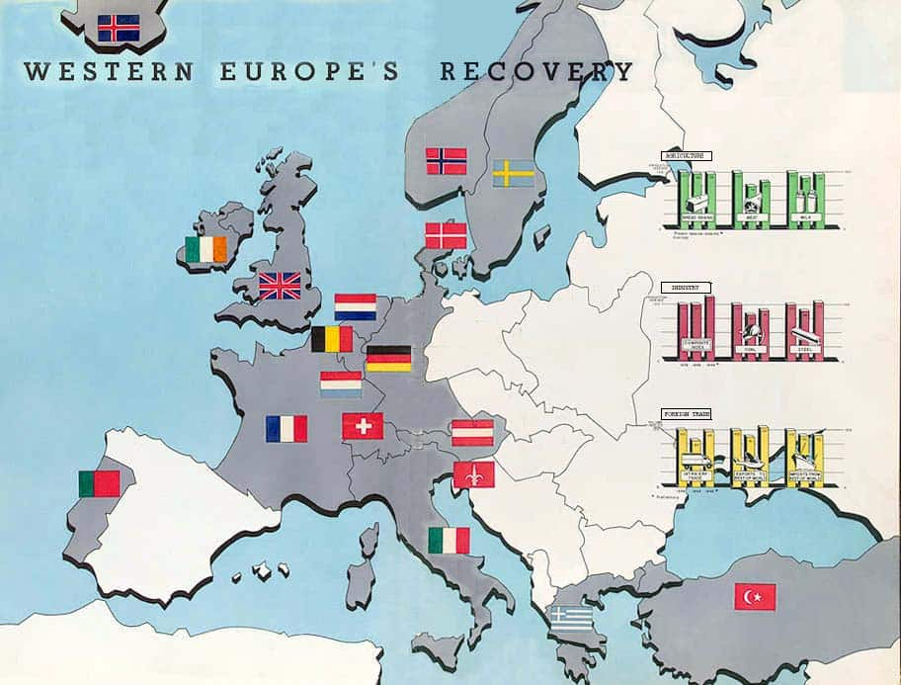
Marshall Plan
The Marshall Plan was introduced by the United States to help aid countries recover from World War II and to prevent the spread of communism.
Established in 1948.
One of the causes of the Marshall Plan was to stop the spread of communism and hoped that the aid would encourage countries to step away from control of the Soviet Union. This plan would further intensify the rivalry between the United States and Soviet Union.

Slide 4
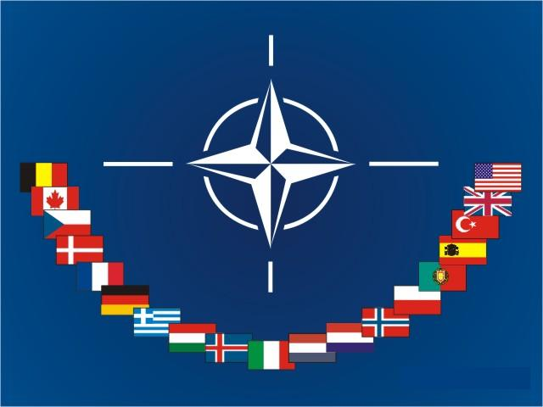
NATO
NATO is the North Atlantic Treaty Organization. It is a military alliance formed by 12 countries in North America and Western Europe to protect its members if they were attacked from other countries. Also, it was made to prevent the spread of communism and protect each other from Soviet Union attacks.
Formed in 1949.
Since NATO was formed as an alliance against the Soviet Union, the rivalry between the countries would increase. This would cause the Soviet Union to see NATO as an aggressive move, resulting in the creation of the Warsaw Pact.

Slide 5

Nuclear Arms Race
A competition between the Soviet Union and United States to see who could get power over the nuclear warfare.
Nuclear Arms Race started in 1950.
The Nuclear Arms Race would intensify the rivalry between the United States and Soviet Union. This is because in this race, these countries are competing against each other, developing a strong hatred during the competition.

Slide 6
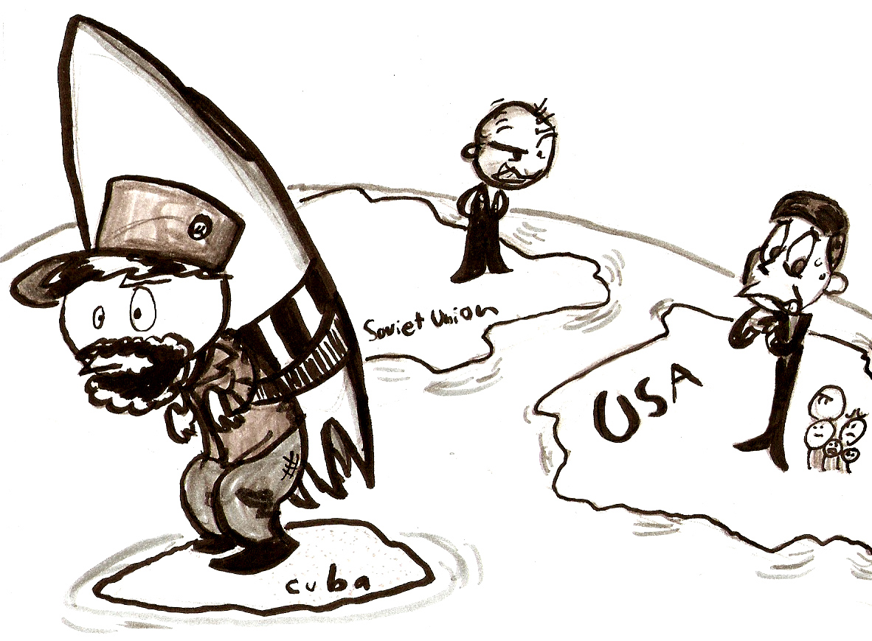
Cuban Missile Crisis
Soviet Union nuclear-armed missiles were located on Cuba, which was 90 miles away from the U.S. shore. J.F.K. was direct in saying that the U.S. would use military force if needed to counteract the missile threat.
The Cuban Missile Crisis occurred in October of 1962.
The Cuban Missile Crisis is the closest that the Cold War came to becoming a nuclear war. The tensions between the nations would increase and their suspensions against each other would grow.

Slide 7
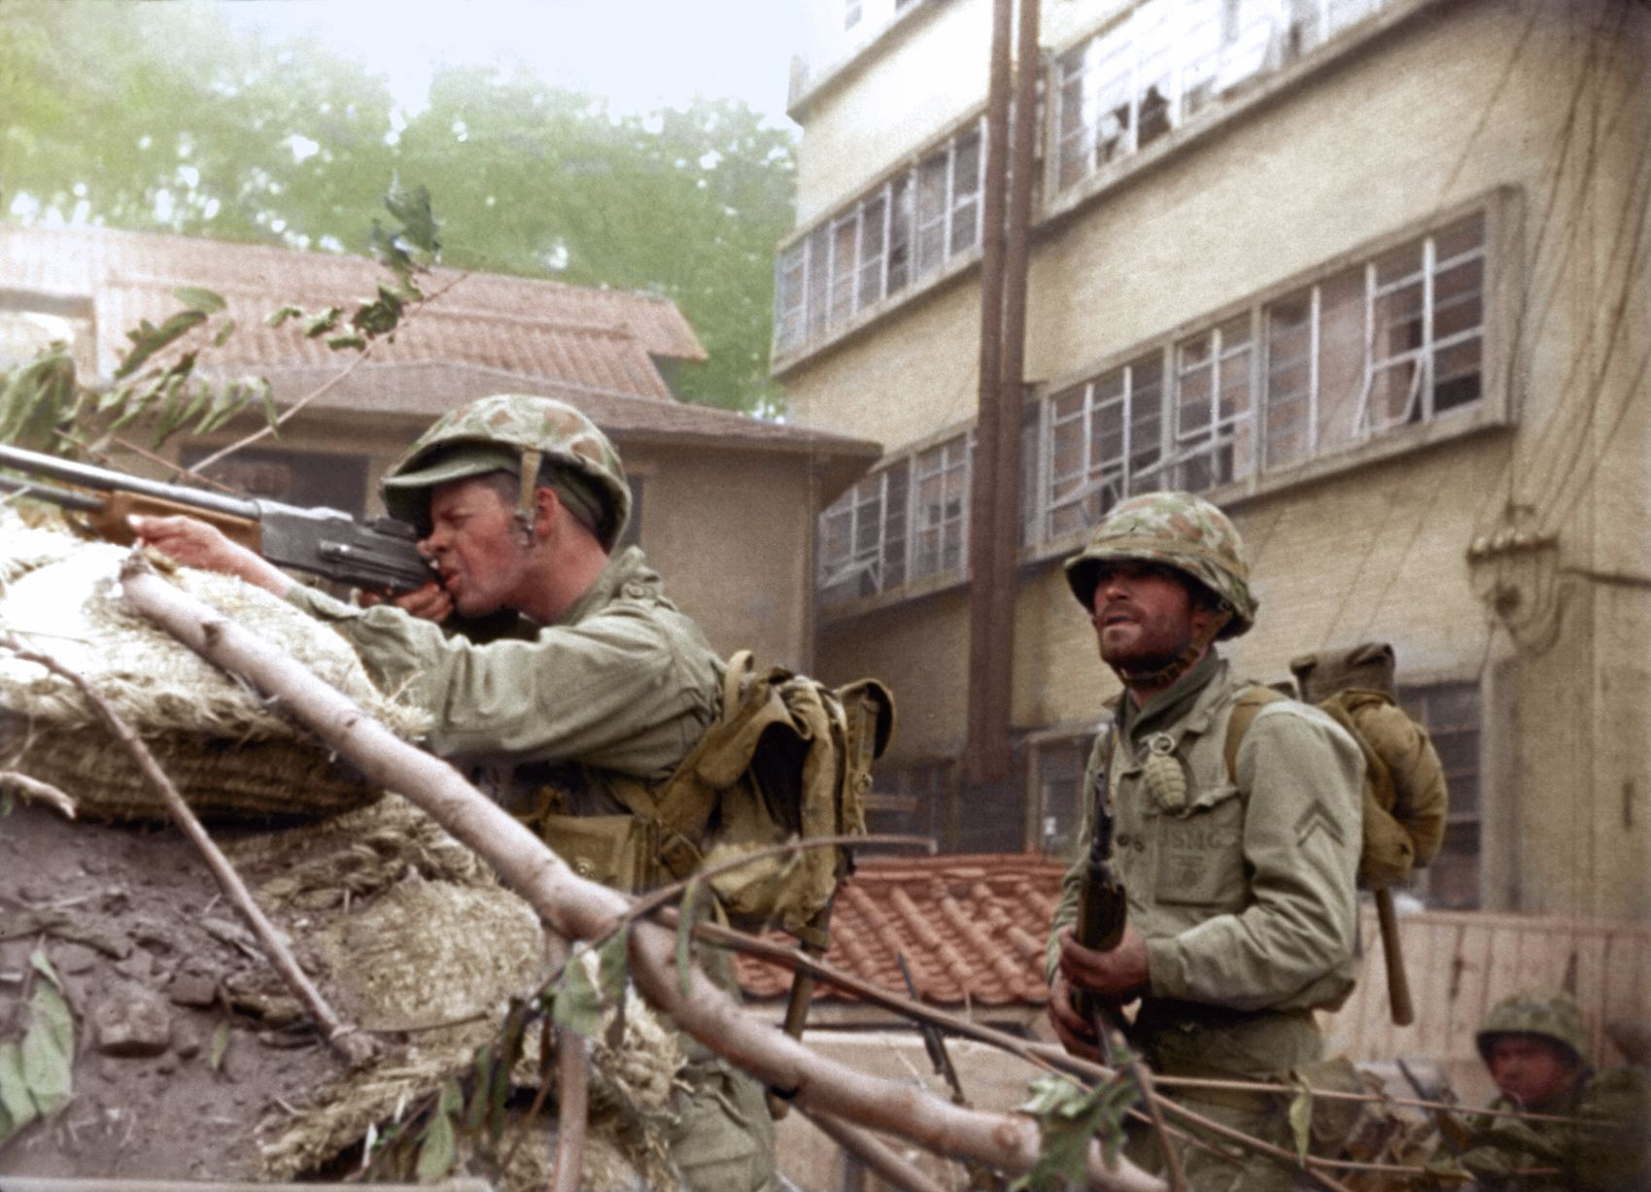
Korean War
North Korea would cross the 38th parallel to attack South Korea. China, the Soviet Union and North Korea wanted the entire Korean Peninsula to be communist, which caused North Korea to attack South Korea, starting the war.
The Korean War lasted from 1950 to 1953.
North Korea, China and the Soviet Union wanted to seek influence upon the South Koreans by forcing them to become communist through force. Then, the United States would want to prevent the spread of communism, thus swooping and getting involved in the war to contain the spread of communism.

Slide 8
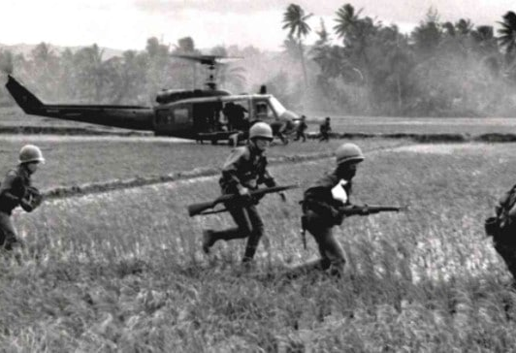
Vietnam War
The brawl between nationalist forces trying to unify Vietnam under a communist government. Meanwhile, the United States, with the help of the South Vietnamese, were trying to prevent the spread of communism.
The Vietnam War lasted from 1959 to 1975.
The Soviet Union would assist North Vietnam, while the United States assisted South Vietnam. Being in a war with your rival would further increase and intensify the rivalry. The Vietnam War would help increase the fear of communists to Americans.

Slide 9
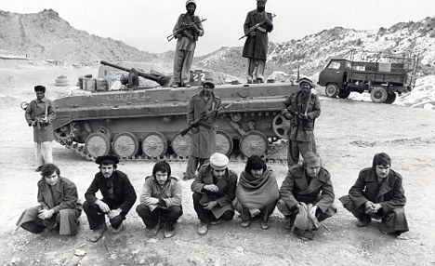
Soviet Invasion of Afghanistan
The Soviet Union invaded Afghanistan and killed the president, Amin. This is because the Soviet Union didn’t trust him and feared he spied for the Americans. It would put Karmal in charge and hopefully stop the Muslim groups from taking over.
The war invasion lasted from 1979 to 1989.
The Soviet Union wanted to maintain influence by eliminating any possible sources that would help the United States. This would allow the Soviets to continue spreading communism without more difficulties.

Slide 10
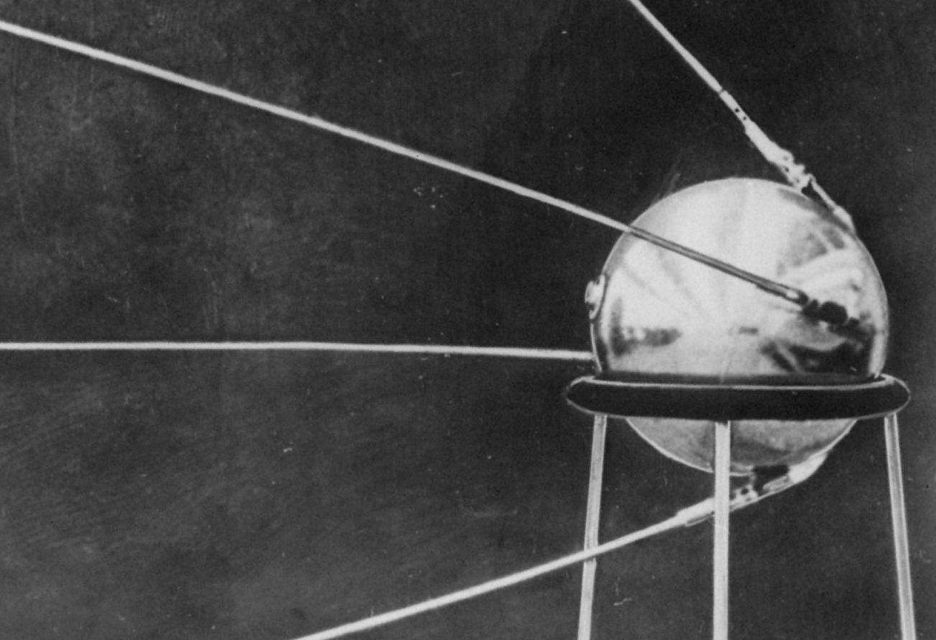
Sputnik
Sputnik was an artificial satellite that was launched into space to orbit the Earth. This caused the United States to be afraid that the Soviets were beating them in space exploration.
Sputnik was launched into space in 1957.
The United States wanted to maintain influence by increasing the spending and accelerate America’s space program to better their rival.

Slide 11
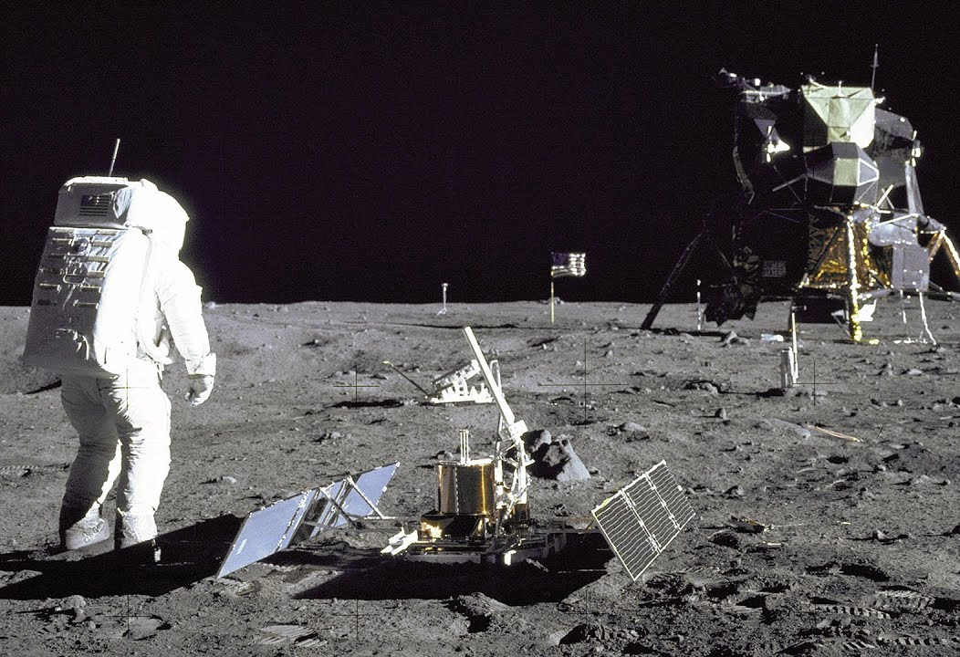
Apollo 11 Moon Landing
Apollo 11 was the first spacecraft to successfully land two men on the moon. The United States would be ahead of the Soviet Union in space exploration at this point.
The Apollo 11 landed on the moon in 1969.
The Soviets would attempt to build lunar space crafts but failed, wanting to prove that they had the better science and technology. The space race escalated the tensions between the United States and Soviet Union.

Slide 12
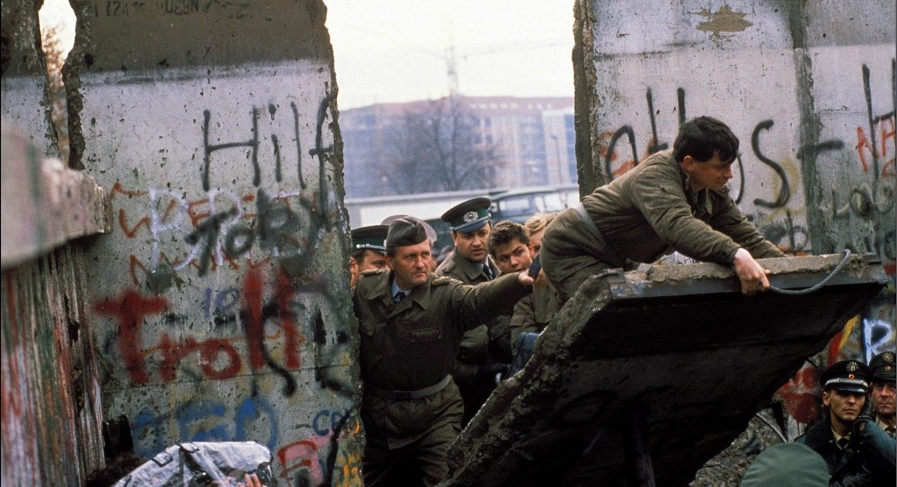
Fall of Berlin Wall
The Fall of the Berlin Wall would lead to the reunification of Germany. The destruction of the wall would get rid of East Germany. This meant the Soviets had to extract their troops from East Germany, while United States troops would stay in West Germany.
The Berlin Wall came down in 1989.
The Fall of the Berlin Wall led to the end of the Cold War. It ended the Warsaw Pact, and an agreement was made. The U.S. and Soviet Union agreed to reduce their nuclear weapons.

Slide 13
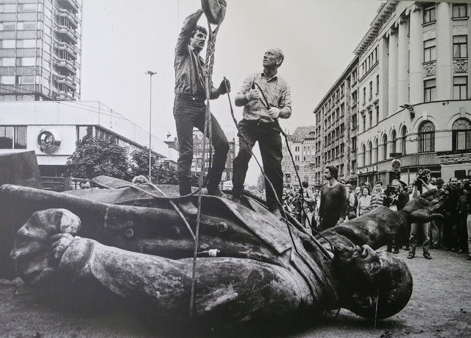
Fall of Soviet Union
Many events would lead to the fall of the Soviet Union. But it would collapse two years after the Berlin Wall. The collapse represented the lifting of the iron curtain.
The Soviet Union fell in 1991.
The Cold War would prove to be too much for the Soviet Union, leading to financial and political struggle within the state. Eventually, the problems stacked upon each other and the public caught on. Then, the republics would break away from the Soviet Union, following the official end of the Soviet Union.

